Slide 1
Welcome to the experiment.
In this experiment you will see a series of words presented on the screen. You will later receive a memory test for these words.
If you have any questions, please ask them now. When you are ready the experiment will begin.

Slide 2
Ready...

Slide 3
TABLE

Slide 4
SIT

Slide 5
LEGS

Slide 6
SEAT

Slide 7
COUCH

Slide 8
DESK

Slide 9
RECLINER

Slide 10
SOFA

Slide 11
WOOD

Slide 12
CUSHION

Slide 13
SWIVEL

Slide 14
STOOL

Slide 15
SITTING

Slide 16
NURSE

Slide 17
SICK

Slide 18
LAWYER

Slide 19
MEDICINE

Slide 20
HEALTH

Slide 21
HOSPITAL

Slide 22
DENTIST

Slide 23
PHYSICIAN

Slide 24
ILL

Slide 25
PATIENT

Slide 26
OFFICE

Slide 27
STETHOSCOPE

Slide 28
SURGEON

Slide 29
SHOE

Slide 30
HAND

Slide 31
TOE

Slide 32
KICK

Slide 33
SANDALS

Slide 34
SOCCER

Slide 35
YARD

Slide 36
WALK

Slide 37
ANKLE

Slide 38
ARM

Slide 39
BOOT

Slide 40
INCH

Slide 41
SOCK

Slide 42
THREAD

Slide 43
PIN

Slide 44
EYE

Slide 45
SEWING

Slide 46
SHARP

Slide 47
POINT

Slide 48
PRICK

Slide 49
THIMBLE

Slide 50
HAYSTACK

Slide 51
THORN

Slide 52
HURT

Slide 53
INJECTION

Slide 54
SYRINGE

Slide 55
WATER

Slide 56
STREAM

Slide 57
LAKE

Slide 58
MISSISSIPPI

Slide 59
BOAT

Slide 60
TIDE

Slide 61
SWIM

Slide 62
FLOW

Slide 63
RUN

Slide 64
BARGE

Slide 65
CREEK

Slide 66
BROOK

Slide 67
FISH

Slide 68
BED

Slide 69
REST

Slide 70
AWAKE

Slide 71
TIRED

Slide 72
DREAM

Slide 73
WAKE

Slide 74
SNOOZE

Slide 75
BLANKET

Slide 76
DOZE

Slide 77
SLUMBER

Slide 78
SNORE

Slide 79
NAP

Slide 80
PEACE

Slide 81
HARD

Slide 82
LIGHT

Slide 83
PILLOW

Slide 84
PLUSH

Slide 85
LOUD

Slide 86
COTTON

Slide 87
FUR

Slide 88
TOUCH

Slide 89
FLUFFY

Slide 90
FEATHER

Slide 91
FURRY

Slide 92
DOWNY

Slide 93
KITTEN

Slide 94
DOOR

Slide 95
GLASS

Slide 96
PANE

Slide 97
SHADE

Slide 98
LEDGE

Slide 99
SILL

Slide 100
HOUSE

Slide 101
OPEN

Slide 102
CURTAIN

Slide 103
FRAME

Slide 104
VIEW

Slide 105
BREEZE

Slide 106
SASH

Slide 107
Very good.
Get out a piece of paper and write down as many of the 50 United State as you can. You have three minutes.

Slide 108
Memory Test
Turn your paper over and number it from 1 to 56.
You will see words on the screen. For each word, write “Y” if you think the word was presented at any time during the experiment. Write “N” if you do not think the word was presented earlier.
If you have any questions, please ask them now. When you are ready, the memory test will begin.

Slide 109
1. TRAFFIC
    Was this word presented earlier?
    Y=Yes
    N=No

Slide 110
2. SOFA
    Was this word presented earlier?
    Y=Yes
    N=No

Slide 111
3. NURSE
    Was this word presented earlier?
    Y=Yes
    N=No

Slide 112
4. TENDER
    Was this word presented earlier?
    Y=Yes
    N=No

Slide 113
5. CHAIR
    Was this word presented earlier?
    Y=Yes
    N=No

Slide 114
6. WINDING
    Was this word presented earlier?
    Y=Yes
    N=No

Slide 115
7. WALK
    Was this word presented earlier?
    Y=Yes
    N=No

Slide 116
8. THREAD
    Was this word presented earlier?
    Y=Yes
    N=No

Slide 117
9. INK
    Was this word presented earlier?
    Y=Yes
    N=No

Slide 118
10. FOOT
    Was this word presented earlier?
    Y=Yes
    N=No

Slide 119
11. TOUCH
    Was this word presented earlier?
    Y=Yes
    N=No

Slide 120
12. SODA
    Was this word presented earlier?
    Y=Yes
    N=No

Slide 121
13. BED
    Was this word presented earlier?
    Y=Yes
    N=No

Slide 122
14. TOWER
    Was this word presented earlier?
    Y=Yes
    N=No

Slide 123
15. KNITTING
    Was this word presented earlier?
    Y=Yes
    N=No

Slide 124
16. RIVER
    Was this word presented earlier?
    Y=Yes
    N=No

Slide 125
17. BENCH
    Was this word presented earlier?
    Y=Yes
    N=No

Slide 126
18. WINDOW
    Was this word presented earlier?
    Y=Yes
    N=No

Slide 127
19. CHESS
    Was this word presented earlier?
    Y=Yes
    N=No

Slide 128
20. SKIN
    Was this word presented earlier?
    Y=Yes
    N=No

Slide 129
21. PRETTY
    Was this word presented earlier?
    Y=Yes
    N=No

Slide 130
22. THIMBLE
    Was this word presented earlier?
    Y=Yes
    N=No

Slide 131
23. BRIDGE
    Was this word presented earlier?
    Y=Yes
    N=No

Slide 132
24. SOFT
    Was this word presented earlier?
    Y=Yes
    N=No

Slide 133
25. SMELL
    Was this word presented earlier?
    Y=Yes
    N=No

Slide 134
26. DOOR
    Was this word presented earlier?
    Y=Yes
    N=No

Slide 135
27. DROWSY
    Was this word presented earlier?
    Y=Yes
    N=No

Slide 136
28. TABLE
    Was this word presented earlier?
    Y=Yes
    N=No

Slide 137
29. BANDIT
    Was this word presented earlier?
    Y=Yes
    N=No

Slide 138
30. HAPPY
    Was this word presented earlier?
    Y=Yes
    N=No

Slide 139
31. SCREEN
    Was this word presented earlier?
    Y=Yes
    N=No

Slide 140
32. OPEN
    Was this word presented earlier?
    Y=Yes
    N=No

Slide 141
33. CLOTH
    Was this word presented earlier?
    Y=Yes
    N=No

Slide 142
34. FEAR
    Was this word presented earlier?
    Y=Yes
    N=No

Slide 143
35. CLIMBER
    Was this word presented earlier?
    Y=Yes
    N=No

Slide 144
36. DOCTOR
    Was this word presented earlier?
    Y=Yes
    N=No

Slide 145
37. FLOW
    Was this word presented earlier?
    Y=Yes
    N=No

Slide 146
38. SHOE
    Was this word presented earlier?
    Y=Yes
    N=No

Slide 147
39. MOUTH
    Was this word presented earlier?
    Y=Yes
    N=No

Slide 148
40. RADIO
    Was this word presented earlier?
    Y=Yes
    N=No

Slide 149
41. TOUGH
    Was this word presented earlier?
    Y=Yes
    N=No

Slide 150
42. NEEDLE
    Was this word presented earlier?
    Y=Yes
    N=No

Slide 151
43. SNOW
    Was this word presented earlier?
    Y=Yes
    N=No

Slide 152
44. SHUTTER
    Was this word presented earlier?
    Y=Yes
    N=No

Slide 153
45. CLINIC
    Was this word presented earlier?
    Y=Yes
    N=No

Slide 154
46. APPLE
    Was this word presented earlier?
    Y=Yes
    N=No

Slide 155
47. ROCKING
    Was this word presented earlier?
    Y=Yes
    N=No

Slide 156
48. WATER
    Was this word presented earlier?
    Y=Yes
    N=No

Slide 157
49. SLEEP
    Was this word presented earlier?
    Y=Yes
    N=No

Slide 158
50. PHYSICIAN
    Was this word presented earlier?
    Y=Yes
    N=No

Slide 159
51. AUNT
    Was this word presented earlier?
    Y=Yes
    N=No

Slide 160
52. YAWN
    Was this word presented earlier?
    Y=Yes
    N=No

Slide 161
53. BLANKET
    Was this word presented earlier?
    Y=Yes
    N=No

Slide 162
54. CURE
    Was this word presented earlier?
    Y=Yes
    N=No

Slide 163
55. HARD
    Was this word presented earlier?
    Y=Yes
    N=No

Slide 164
56. CRUST
    Was this word presented earlier?
    Y=Yes
    N=No

Slide 165
Nice job! Now let’s score the data….
--Count up the number of “yes” responses you gave for the following numbers on your answer sheet: 2, 3, 7, 8, 11, 13, 22, 26, 28, 32, 37, 38, 48, 50, 53, 55. Write down this total and label it “studied items.”
--Count up the number of “yes” responses you gave for the following numbers on your answer sheet: 5, 10, 16, 18, 24, 36, 42, 49. Write down this total and label it “critical lures.”
--Count up the number of “yes” responses you gave for the following numbers on your answer sheet: 4, 6, 15, 17, 20, 23, 25, 27, 31, 33, 39, 44, 45, 47, 52, 54. Write down this total and label it “weakly related lures.”
--Count up the number of “yes” responses you gave for the following numbers on your answer sheet: 1, 9, 12, 14, 19, 21, 29, 30, 34, 35, 40, 41, 43, 46, 51, 56. Write down this total and label it “unrelated lures.”

Slide 166
Debrief
This experiment is a replication of Roediger and McDermott (1995). It is a popular and widely-replicated method for creating false memories of words that were not presented. It is an extension of a paper published by Deese (1959), and therefore this phenomenon is commonly called the Deese-Roediger-McDermott effect, or the DRM effect.

Slide 167
Methods
There were four types of words presented on the memory test. “Studied Items” were words that were actually presented during the first part of the experiment. You may have noticed that many of the studied items were related to each other. “Critical Lures” were words that were not presented earlier in the experiment, but they were strongly related to some of the studied items. “Weakly Related Lures” were also not presented earlier, and they were only weakly related to studied items. “Unrelated Lures” were not presented in the experiment and were unrelated to any of the studied words.

Slide 168
Sample DRM Stimuli
Critical Lures
ANGER
Mad
Fear
Hate
Rage
Temper
Fury
Ire
Wrath
Happy
Fight
Hatred
Mean
Calm
Emotion
Enrage
FRUIT
Apple
Vegetable
Orange
Kiwi
Citrus
Ripe
Pear
Banana
Berry
Cherry
Basket
Juice
Salad
Bowl
Cocktail
HIGH
Low
Clouds
Up
Tall
Tower
Jump
Above
Building
Noon
Cliff
Sky
Over
Airplane
Dive
Elevate
KING
Queen
England
Crown
Prince
George
Dictator
Palace
Throne
Chess
Rule
Subjects
Monarch
Royal
Leader
Reign
SPIDER
Web
Insect
Bug
Fright
Fly
Arachnid
Crawl
Tarantula
Poison
Bite
Creepy
Animal
Ugly
Feelers
Small
Studied words

Slide 169
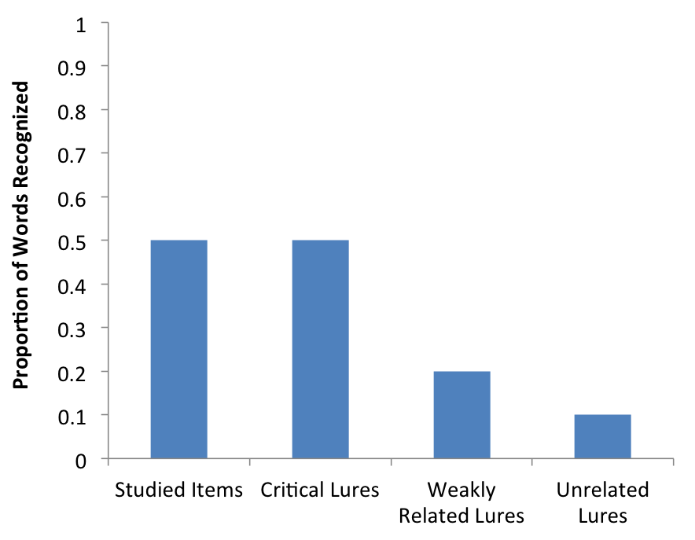
Results
Responding “Yes” to Studied Items reflects correct recognition. Responding “Yes” to Critical Lures, Weakly Related Lures, and Unrelated Lures reflects false recognition. As you can see, Critical Lures (which did not appear in the experiment) are oft en recognized at rates comparable to the Studied Items that actually did appear earlier.
This presents an easy and effective way of studying false memory.

Slide 170
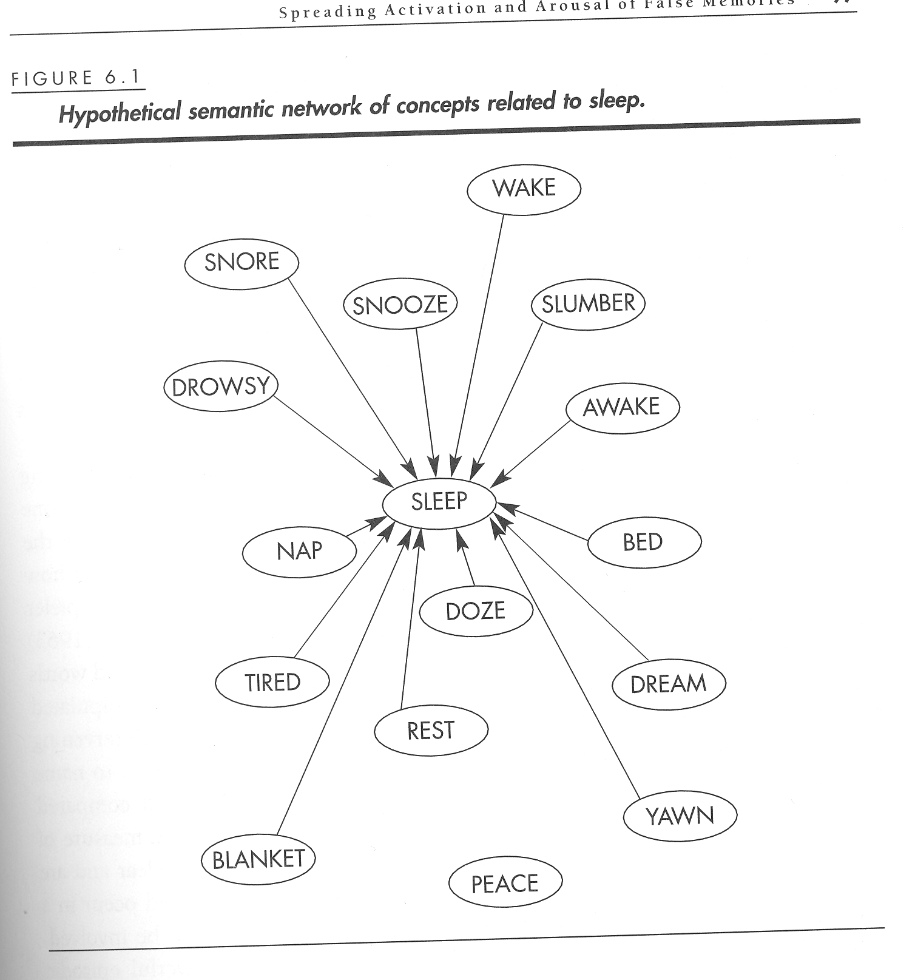
Discussion
Gist-based memory
Semantic networks
Criticisms

